Slide 1
System Hacking Basic
조성준

Slide 2
발표자 소개
조성준 (a.k.a. DelspoN)
2019 ICEWALL 회장
ReverseLab
시스템해킹 & 웹해킹
CTF & 버그헌팅
버그헌팅 경험 다수
CTF 경험 다수
컨퍼런스 발표 경험 다수
delspon.com
fb.com/INJECT7

Slide 3

목차
Basic Reversing
gdb & plugins
IDA
Command Injection
Basic
Magic Characters
Stack BOF
32bit
Basic
Shellcode
Canary
ROP
Return to Libc
64bit

Slide 4
Basic Reversing : Compile
일대일대응
Code
Assembly
Binary
#include <stdio.h>
int main() {
int a = 1;
printf("Number : %d", a);
return 0;
}

Slide 5
Basic Reversing : Compile
일대일대응
Code
Assembly
Binary
Dump of assembler code for function main:
0x0804840b <+0>: lea ecx,[esp+0x4]
0x0804840f <+4>: and esp,0xfffffff0
0x08048412 <+7>: push DWORD PTR [ecx-0x4]
0x08048415 <+10>: push ebp
0x08048416 <+11>: mov ebp,esp
0x08048418 <+13>: push ecx
0x08048419 <+14>: sub esp,0x14
0x0804841c <+17>: mov DWORD PTR [ebp-0xc],0x1
0x08048423 <+24>: sub esp,0x8
0x08048426 <+27>: push DWORD PTR [ebp-0xc]
0x08048429 <+30>: push 0x80484d0
0x0804842e <+35>: call 0x80482e0 <printf@plt>
0x08048433 <+40>: add esp,0x10
0x08048436 <+43>: mov eax,0x0
0x0804843b <+48>: mov ecx,DWORD PTR [ebp-0x4]
0x0804843e <+51>: leave
0x0804843f <+52>: lea esp,[ecx-0x4]
0x08048442 <+55>: ret
End of assembler dump.

Slide 6
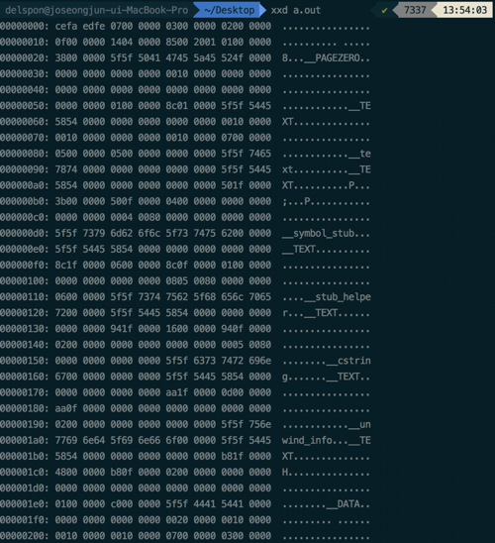
Basic Reversing : Compile
일대일대응
Code
Assembly
Binary

Slide 7
Basic Reversing : Reversing
일대일대응
Code
Assembly
Binary

Slide 8
Basic Reversing : Reversing
일대일대응
Code
Assembly
Binary
Dump of assembler code for function main:
0x0804840b <+0>: lea ecx,[esp+0x4]
0x0804840f <+4>: and esp,0xfffffff0
0x08048412 <+7>: push DWORD PTR [ecx-0x4]
0x08048415 <+10>: push ebp
0x08048416 <+11>: mov ebp,esp
0x08048418 <+13>: push ecx
0x08048419 <+14>: sub esp,0x14
0x0804841c <+17>: mov DWORD PTR [ebp-0xc],0x1
0x08048423 <+24>: sub esp,0x8
0x08048426 <+27>: push DWORD PTR [ebp-0xc]
0x08048429 <+30>: push 0x80484d0
0x0804842e <+35>: call 0x80482e0 <printf@plt>
0x08048433 <+40>: add esp,0x10
0x08048436 <+43>: mov eax,0x0
0x0804843b <+48>: mov ecx,DWORD PTR [ebp-0x4]
0x0804843e <+51>: leave
0x0804843f <+52>: lea esp,[ecx-0x4]
0x08048442 <+55>: ret
End of assembler dump.

Slide 9
Basic Reversing : Reversing
일대일대응
Code
Assembly
Binary
#include <stdio.h>
int main() {
int a = 1;
printf("Number : %d", a);
return 0;
}

Slide 10
Let’s Practice
sudo apt install gdb
git clone https://github.com/longld/peda.git ~/peda
echo "source ~/peda/peda.py" >> ~/.gdbinit
echo "DONE! debug your program with gdb and enjoy"

Slide 11
Let’s Practice
sudo dpkg --add-architecture i386
sudo apt-get update
sudo apt-get install libc6:i386 libncurses5:i386 libstdc++6:i386 zlib1g:i386
#include <stdio.h>
int main() {
int a = 1;
printf("Number : %d", a);
return 0;
}
gcc -o p0 p0.c
./p0
gdb ./p0

Slide 12
Let’s Practice
#include <stdio.h>
int main() {
int a = 1;
printf("Number : %d", a);
return 0;
}
gcc -o p0 p0.c –m32
./p0
gdb ./p0
+ IDA

Slide 13
Command Injection
리눅스 커맨드
echo "string"
ls –l
sleep 3
…
프로그램에서도 사용 가능
system("echo \"string\"")
system("ls –l")
system("sleep 3")
…

Slide 14
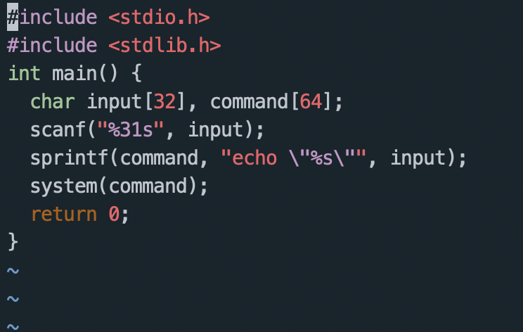
Command Injection

Slide 15



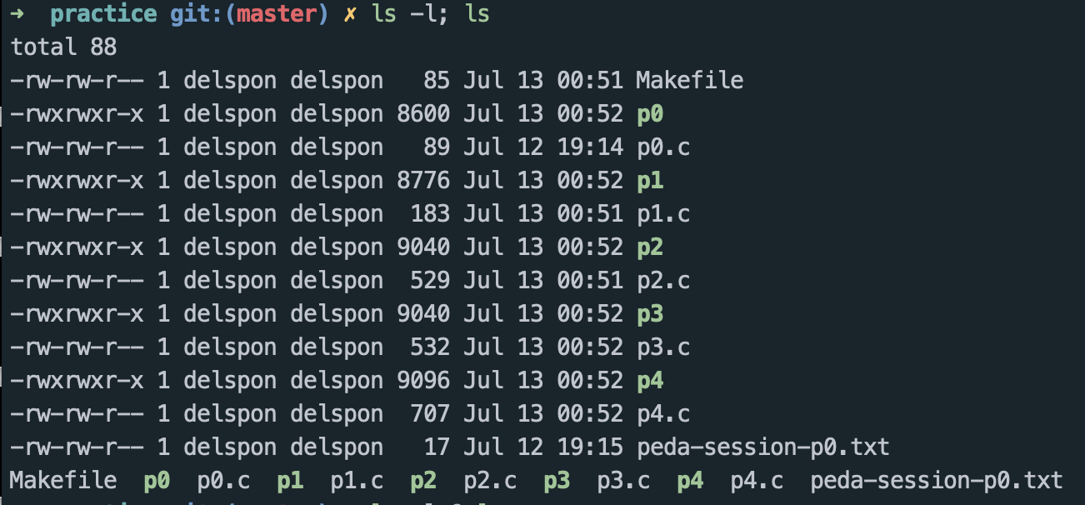
Command Injection

Slide 16
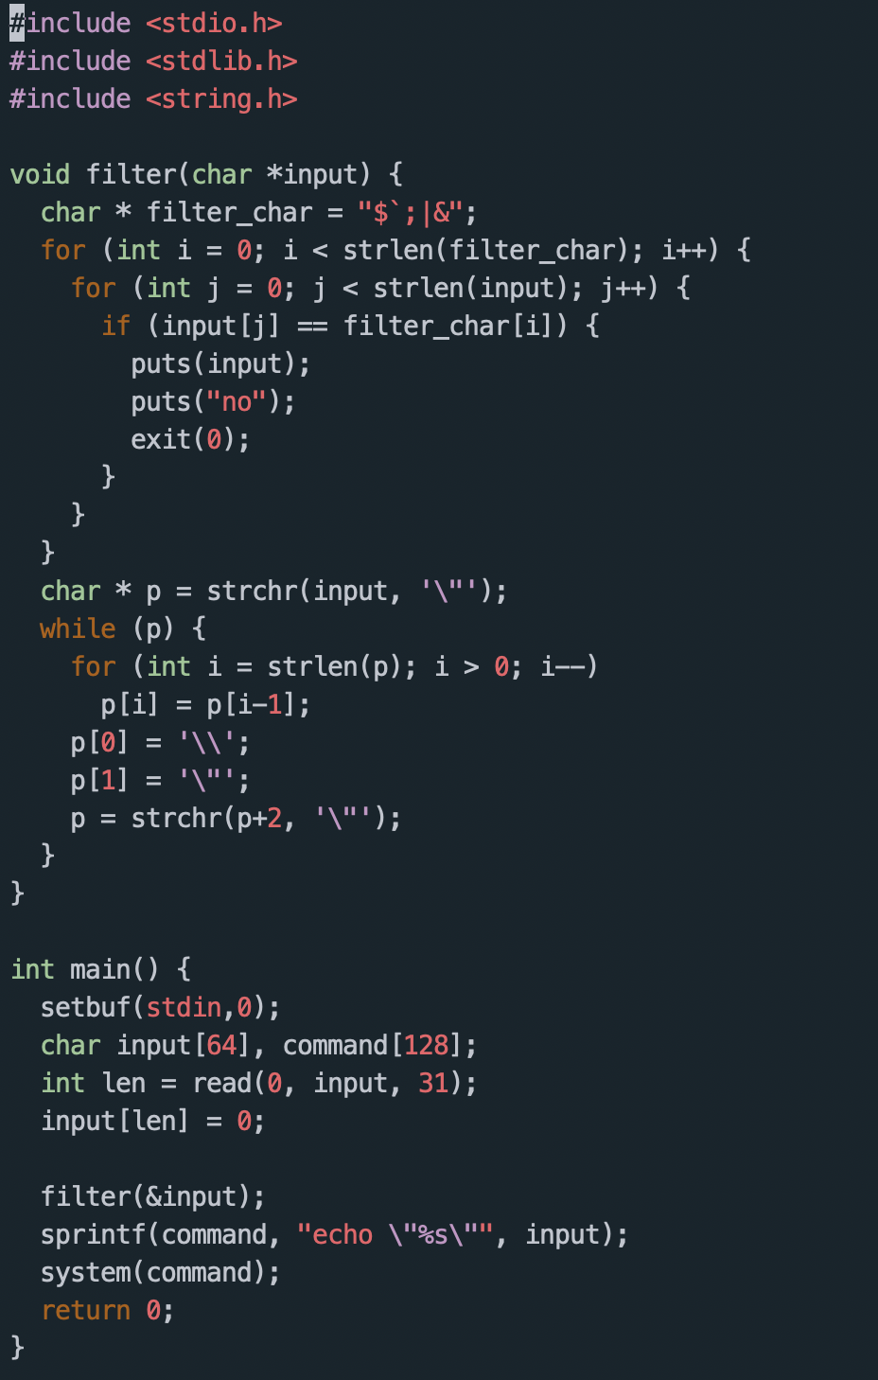
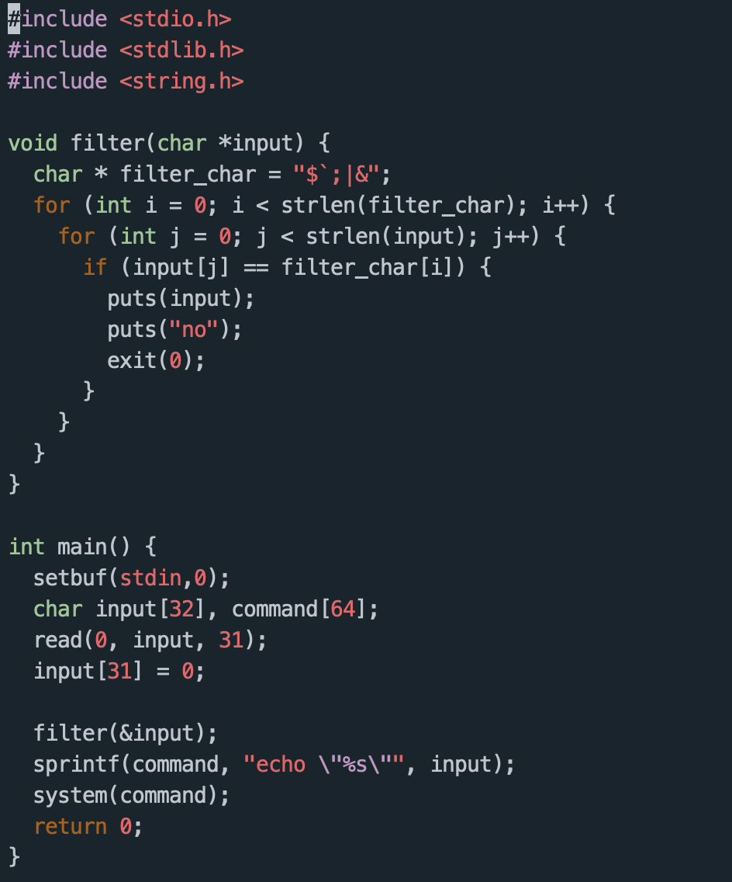
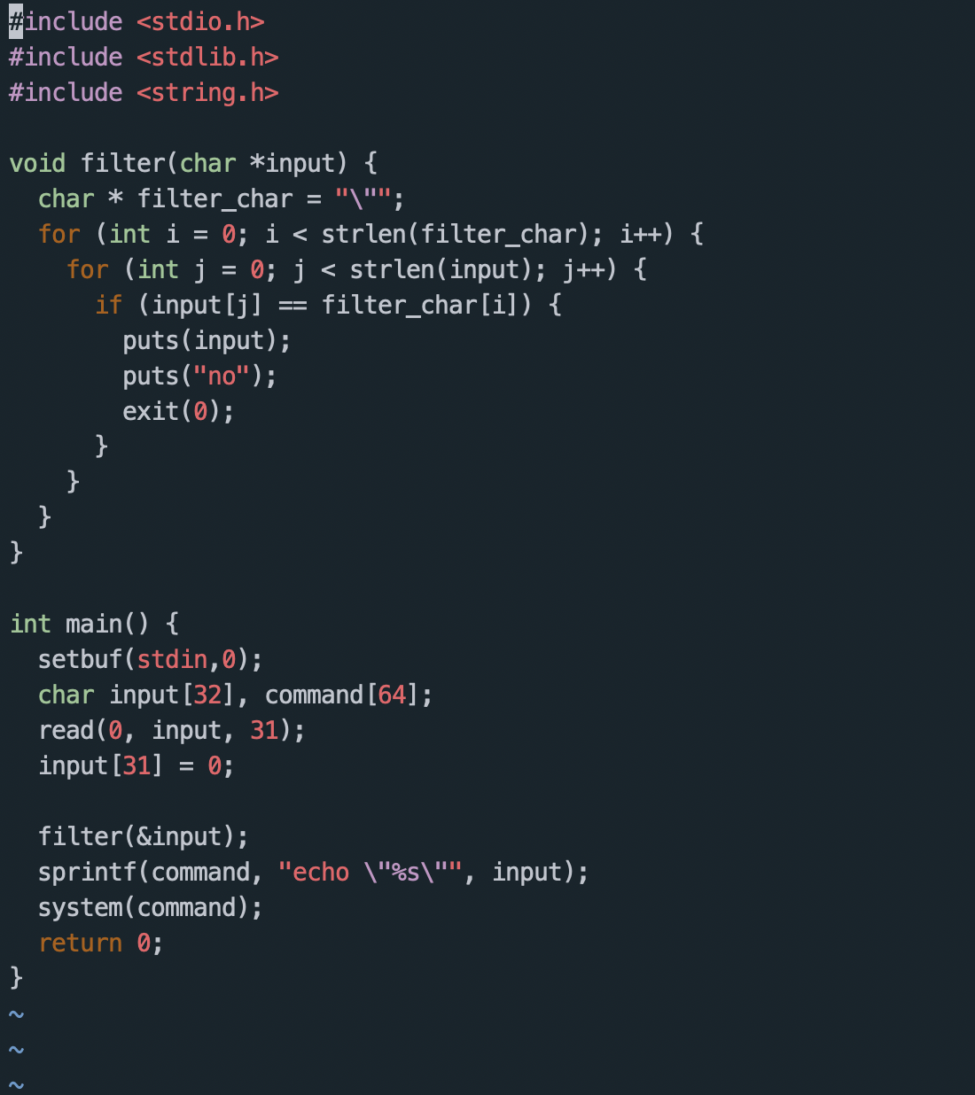
Command Injection : 실습

Slide 17
Command Injection : 실습

Slide 18
Command Injection : 실습

Slide 19
Command Injection : 실습

Slide 20
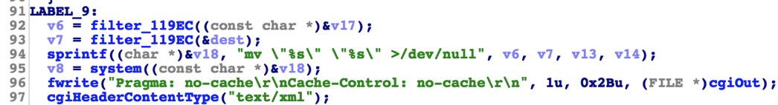
Command Injection : 1day case

Slide 21
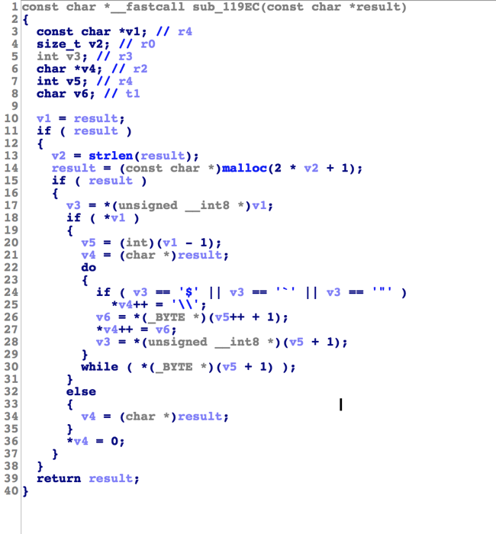
Command Injection : 1day case

Slide 22
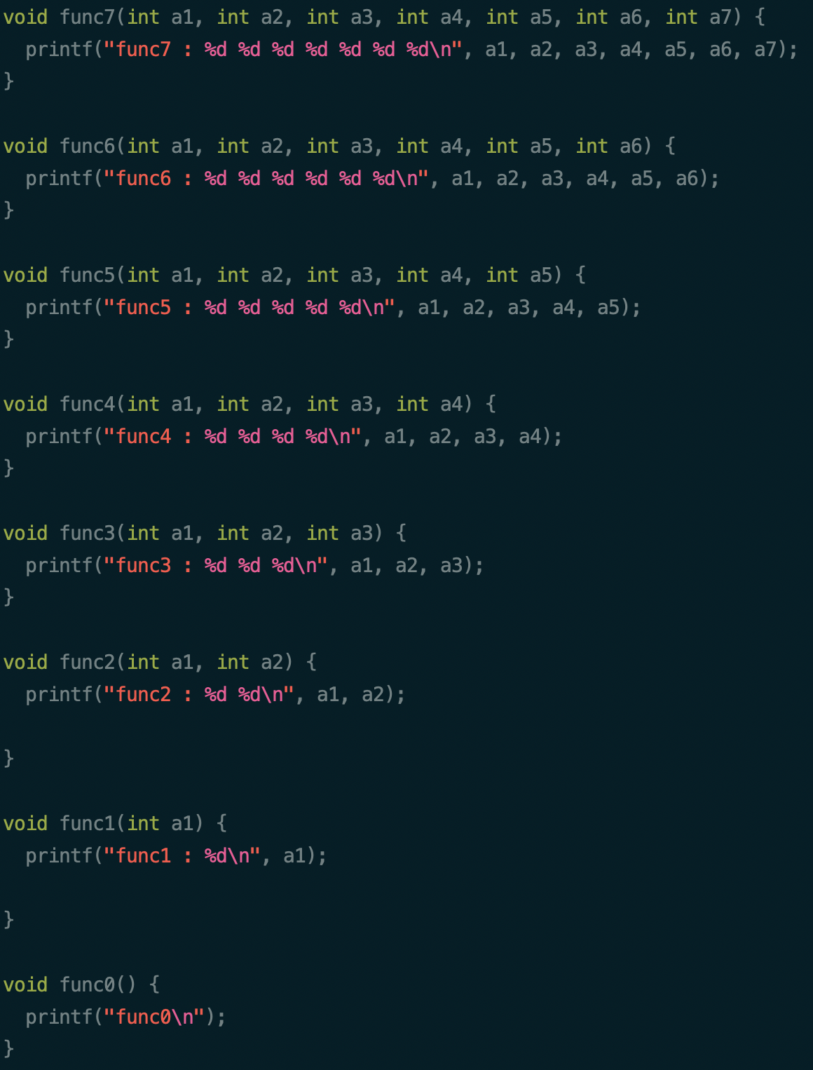
Stack BOF : Calling Convention
gcc -o p5_32 p5.c –m32
gcc -o p5_64 p5.c
./p5_32
./p5_64
gdb ./p5_32
gdb ./p5_64

Slide 23
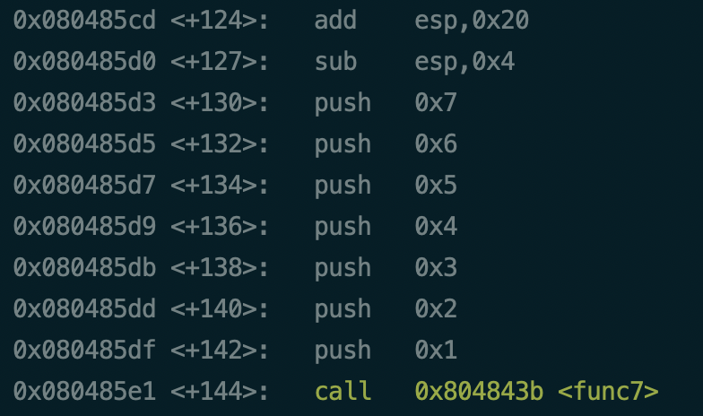
Stack BOF : 32bit

Slide 24
Stack BOF : 32bit
1
2
3
4
5
6
7
…

Slide 25
Stack BOF : 32bit
Return Address
Saved Frame Pointer
1
2
3
4
5
6
7
…

Slide 26
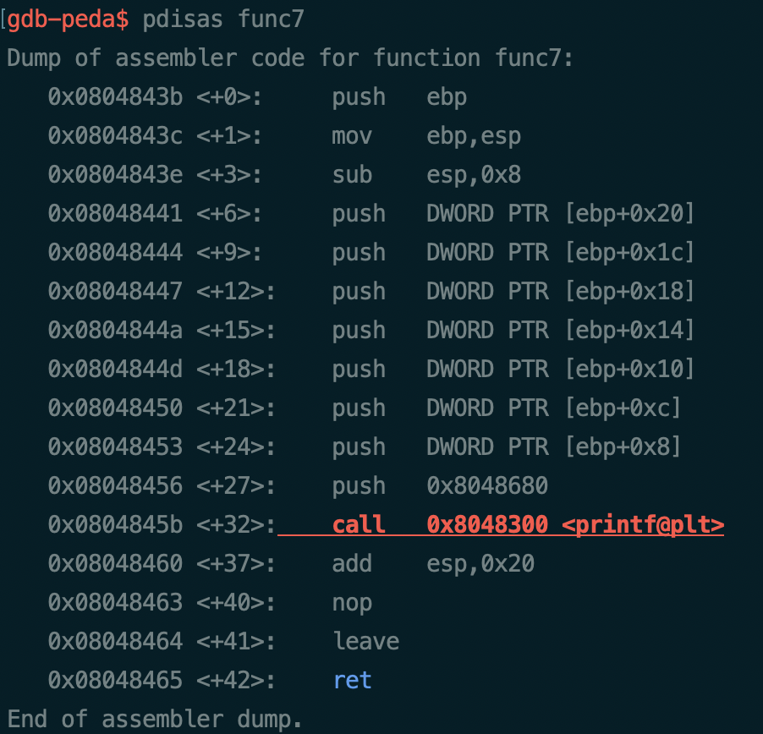
Stack BOF : 32bit
func7 Local Area
Return Address
Saved Frame Pointer
1
2
3
4
5
6
7
…

Slide 27
Stack BOF : 32bit
실습

Slide 28
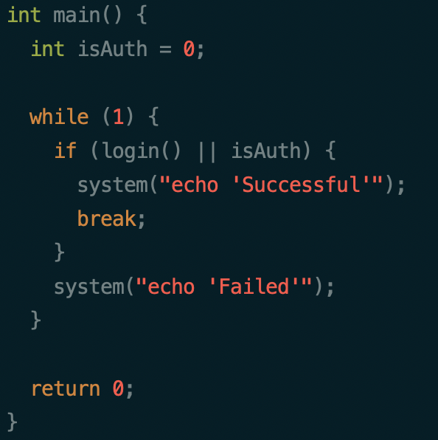
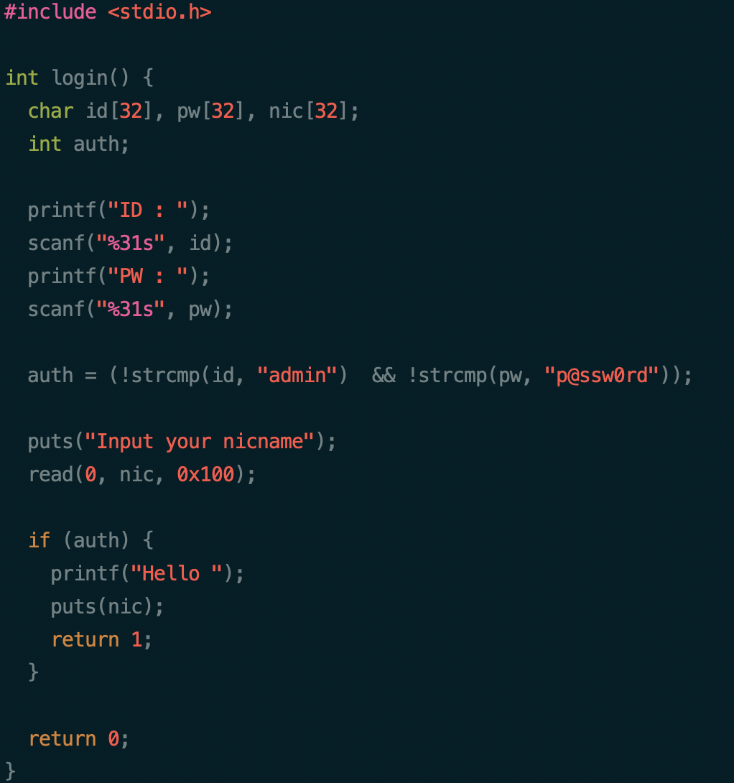
Stack BOF : Basic

Slide 29
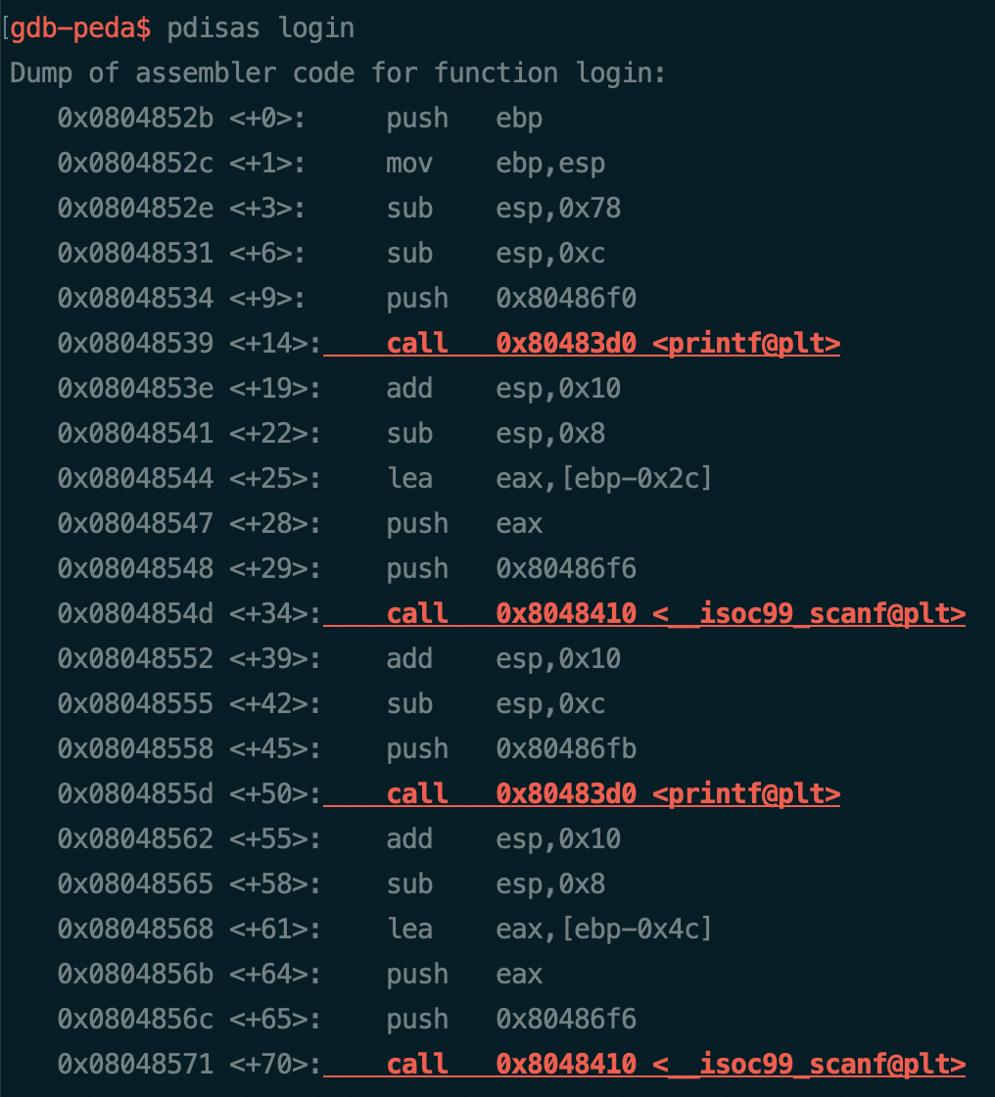
Stack BOF : Basic

Slide 30
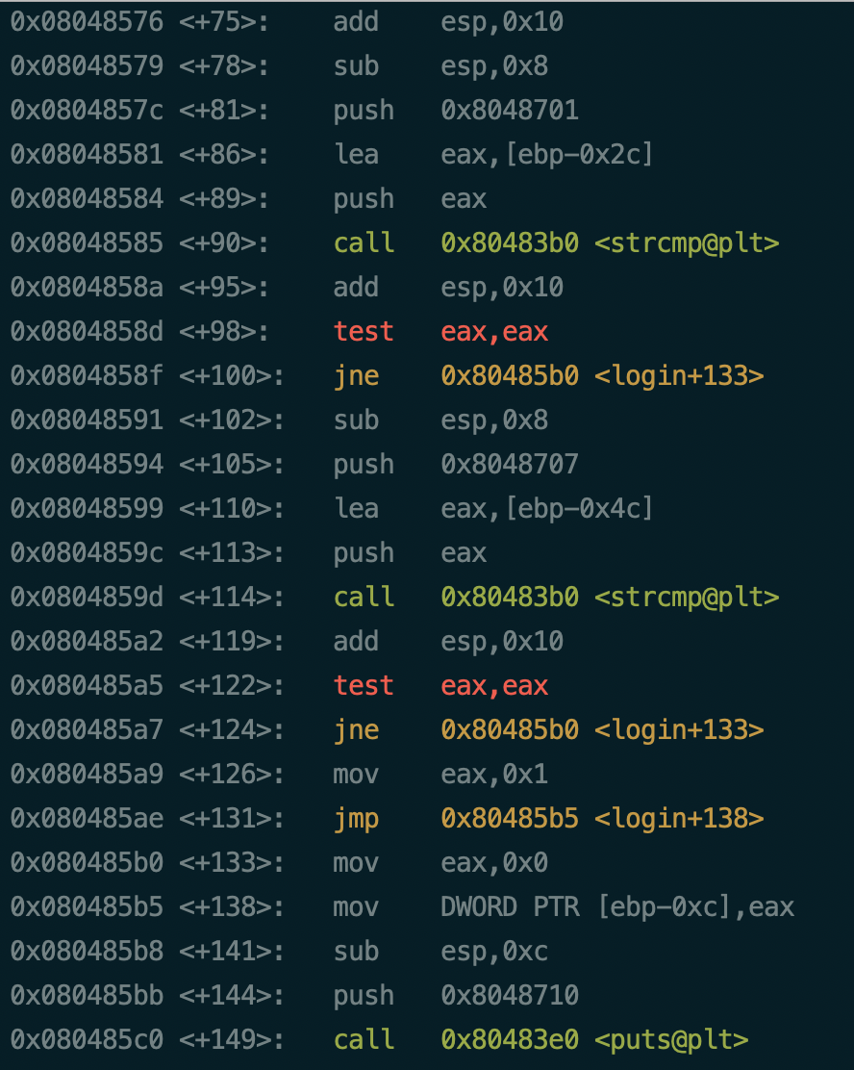
Stack BOF : Basic

Slide 31
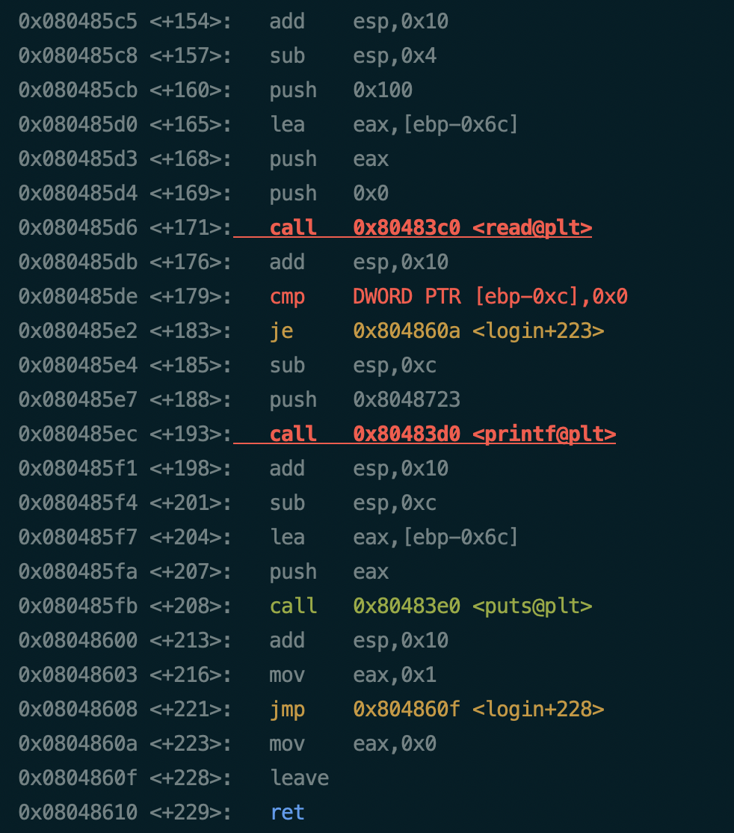
Stack BOF : Basic

Slide 32
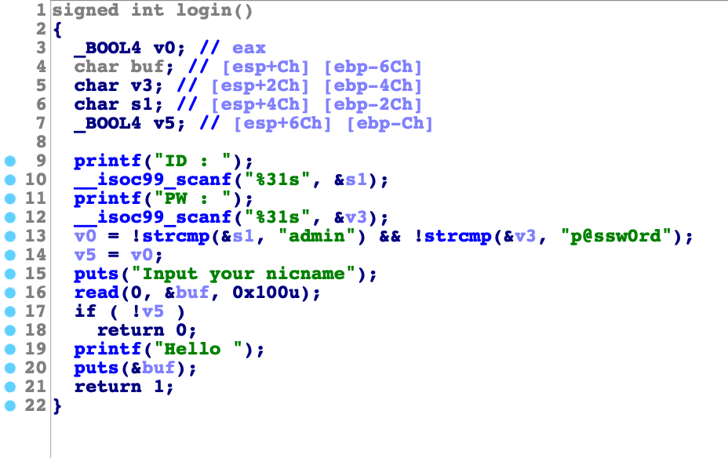
Stack BOF : Basic

Slide 33
Stack BOF : Basic
…
nic[32]
pw[32]
id[32]
auth
…
Return Address
Saved Frame Pointer
…

Slide 34
Stack BOF : Basic
…
nic[32]
pw[32]
id[32]
auth
…
Return Address
Saved Frame Pointer
…

Slide 35
Stack BOF : Basic
실습

Slide 36
Stack BOF : Basic
…
nic[32]
pw[32]
id[32]
auth
…
Return Address
Saved Frame Pointer
…
Somewhere

Slide 37
Stack BOF : Basic
실습

Slide 38
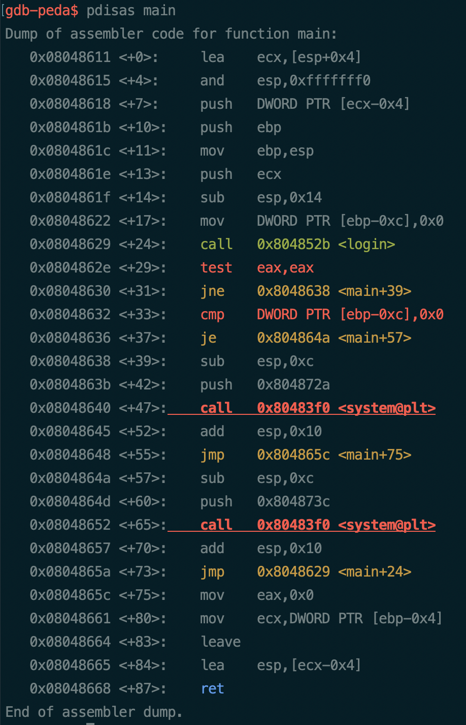
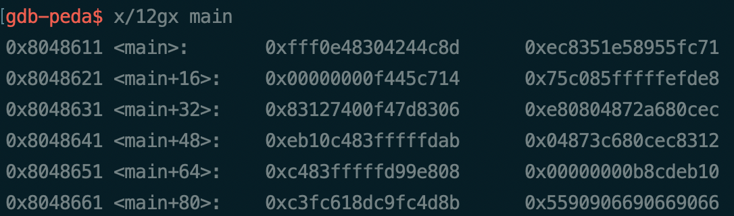
Stack BOF : Shellcode
숫자로 코드 작성 가능

Slide 39
Stack BOF : Shellcode
…
nic[32]
pw[32]
id[32]
auth
…
Return Address
Saved Frame Pointer
…
Shellcode

Slide 40
Stack BOF : Shellcode
…
Shellcode
Return Address
Saved Frame Pointer
…

Slide 41
Stack BOF : Shellcode
어떻게 막을까?

Slide 42
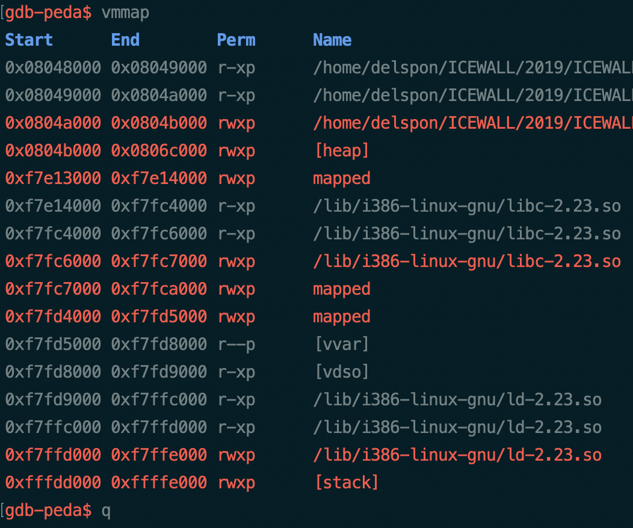
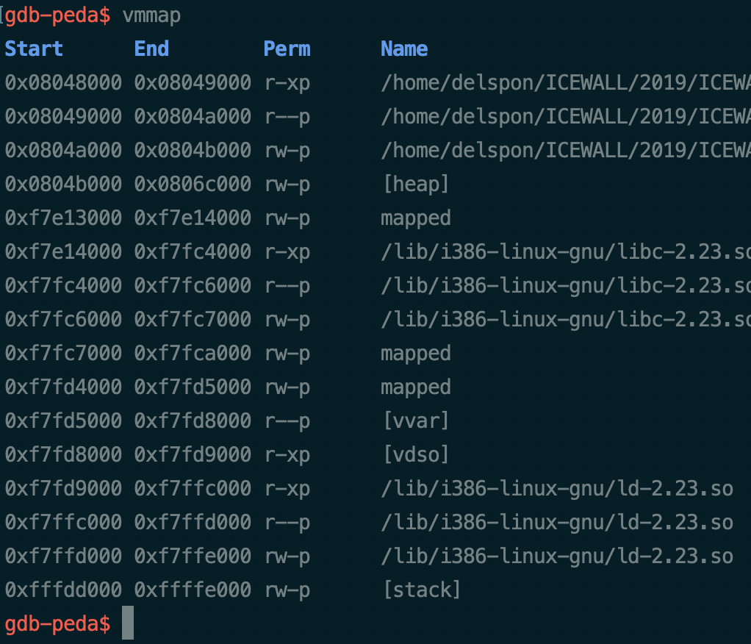
Stack BOF : Shellcode

Slide 43
Stack BOF : Canary
…
nic[32]
pw[32]
id[32]
auth
…
Canary
Return Address
Saved Frame Pointer
…
검증값 삽입

Slide 44
Stack BOF : Canary
어떻게 뚫을까?

Slide 45
Stack BOF : Canary
…
nic[32]
pw[32]
id[32]
auth
…
Canary
Return Address
Saved Frame Pointer
…
Leak : 검증값 읽기

Slide 46
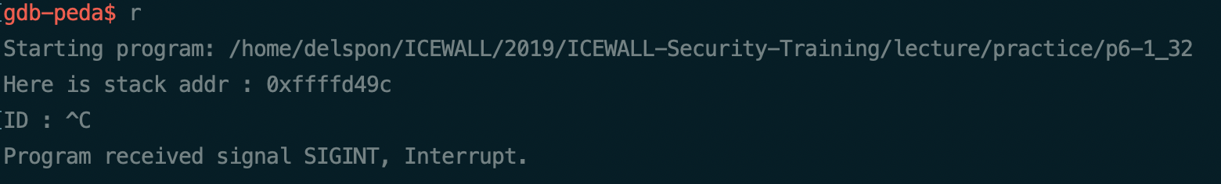
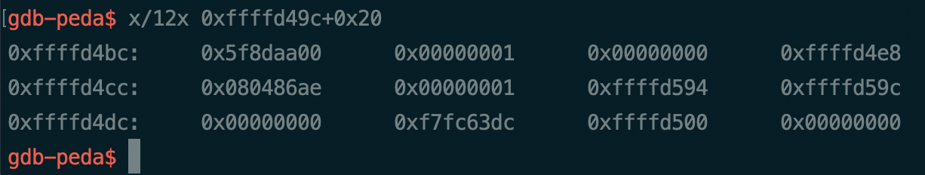
Stack BOF : Canary

Slide 47
Stack BOF : Canary
Leak 실습

Slide 48
Stack BOF : Canary
Exploit 실습

Slide 49
Stack BOF : ROP
Return Oriented Programming
원하는 코드 실행 가능

Slide 50
끝

Slide 51
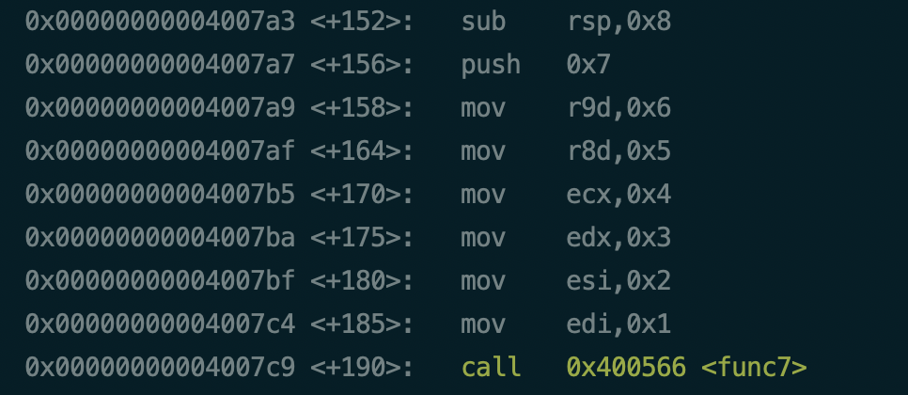
Stack BOF : 64bit

Slide 52
Stack BOF : 64bit
RDI : 0x1
RSI : 0x2
RDX : 0x3
RCX : 0x4
R8 : 0x5
R9 : 0x6
7
…

Slide 53
Stack BOF : 64bit
RDI : 0x1
RSI : 0x2
RDX : 0x3
RCX : 0x4
R8 : 0x5
R9 : 0x6
Return Address
Saved Frame Pointer
7
…

Slide 54
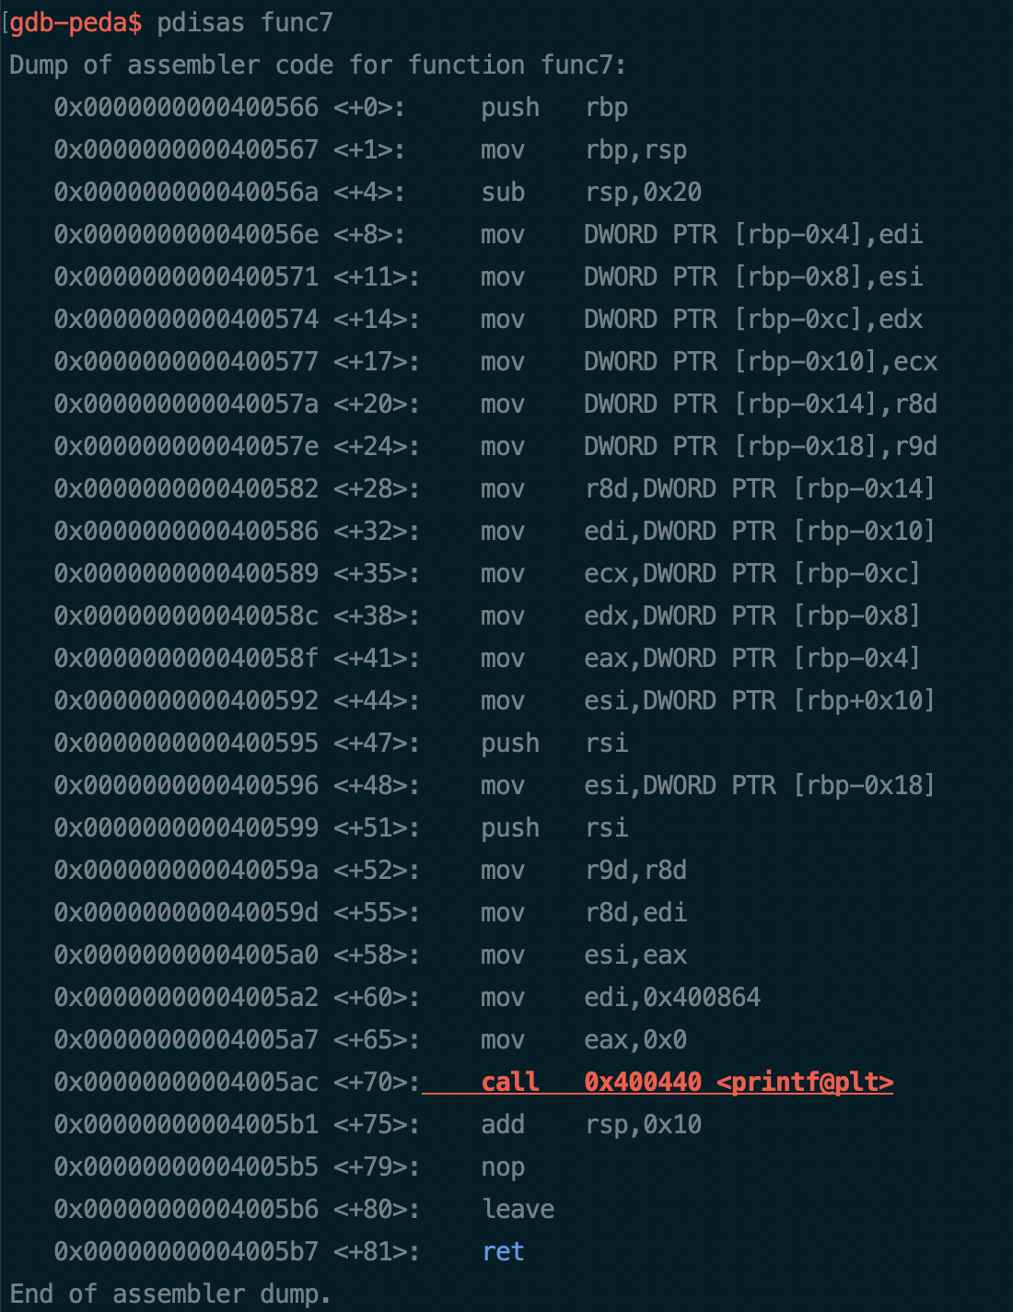
Stack BOF : 64bit
func7 Local Area
Return Address
Saved Frame Pointer
7
…
RDI : 0x1
RSI : 0x2
RDX : 0x3
RCX : 0x4
R8 : 0x5
R9 : 0x6

Slide 55
Stack BOF : 64bit
1, 2
5, 6
4, 3
2, 1
…
RDI : 0x1
RSI : 0x2
RDX : 0x3
RCX : 0x4
R8 : 0x5
R9 : 0x6

Slide 56
Stack BOF : 64bit
6, 7
6, 5
4, 3
2, 1
…
RDI : “func7 : %d %d …”
RSI : 0x1
RDX : 0x2
RCX : 0x3
R8 : 0x4
R9 : 0x5

Slide 57
Stack BOF : 64bit
Return Address
Saved Frame Pointer
6, 7
6, 5
4, 3
2, 1
…
RDI : “func7 : %d %d …”
RSI : 0x1
RDX : 0x2
RCX : 0x3
R8 : 0x4
R9 : 0x5

Slide 58
Stack BOF : 64bit
실습
64비트에서는 함수 인자 전달을 어떻게 하는지 알아보자

